Slide 1
Smart Gardening System
Hafiz Zeeshan Yousaf
S5130511

Slide 2
Table Of Content:
Introduction
Microcontroller & Sensors
MQTT Protocol
Ubidots Platform
Dashboard

Slide 3
Introduction:
Automate the gardening process
Fire Detection
Motion Detection
Soil moister Detection
Water Tank Level Monitoring
Motor On/Off via Ubidots(Data Visualization)
Simulator(Wokwi)

Slide 4
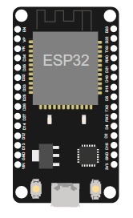
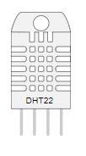
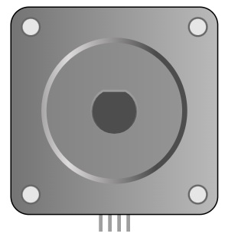
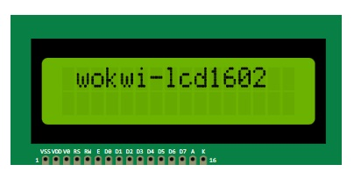



Microcontroller & Sensors:
ESP32 (Microcontroller)
DHT22
PIR Motion Sensor
Photoresistor LDR
Soil Sensor
Motor
LCD

Slide 5
Message Queuing Telemetry Transport (MQTT) Protocol:
MQTT is a lightweight, publish-subscribe, machine to machine network protocol for message queue/message queuing service.
In my project, ubidots is the subscriber and wokwi is the publisher and vice versa.

Slide 6
Ubidots Platform:
Ubidots is an IoT Application Enablement Platform (AEP) enabling System Integrators (SIs) and SMBs to rapidly assemble and launch IoT applications.
In my project, I am using ubidots to show data which is coming from wokwi simulator and also I am sending data from ubidots to wokwi using mqtt.

Slide 7
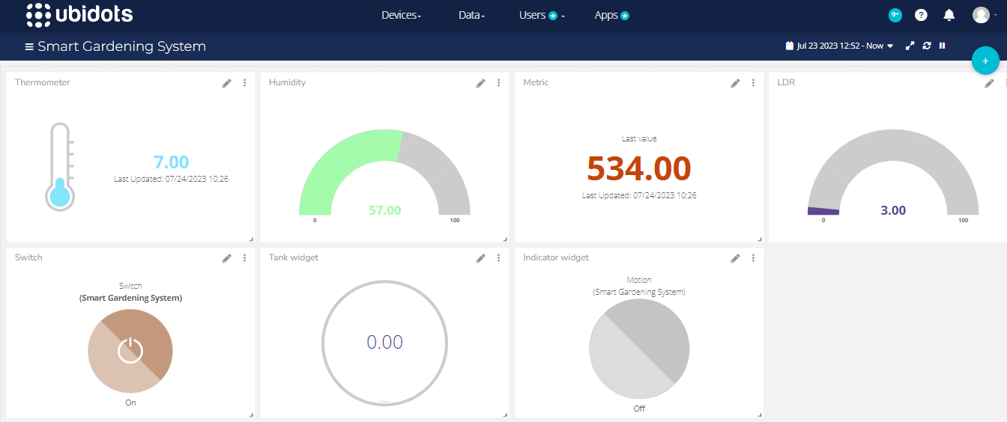
Dashboard:

Slide 8
Conclusion:
In the end, Smart gardening system will help a lot people and minimize their efforts and expenses to maintain the garden beautifully by providing smart screening system via ubidots.

Slide 9
Thank You!

